Slide 1
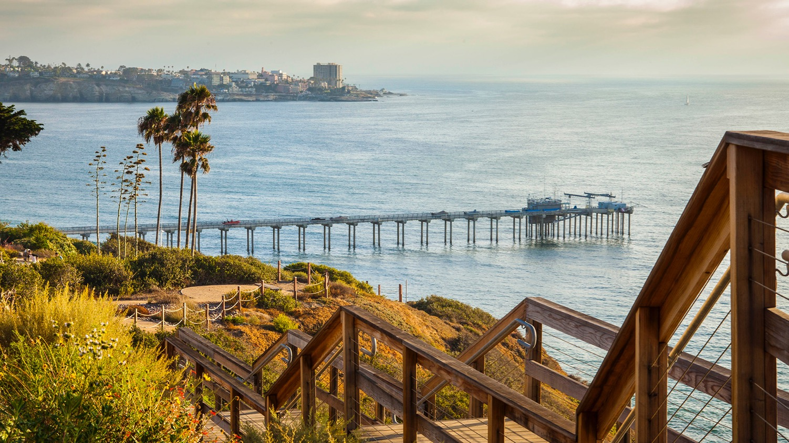
Reproducible Science & Data Management
August 5, 2021
Mathew Biddle (ORCiD: 0000-0003-4897-1669)
Slides adapted from OHW 2020 by Joseph Gum

Slide 2
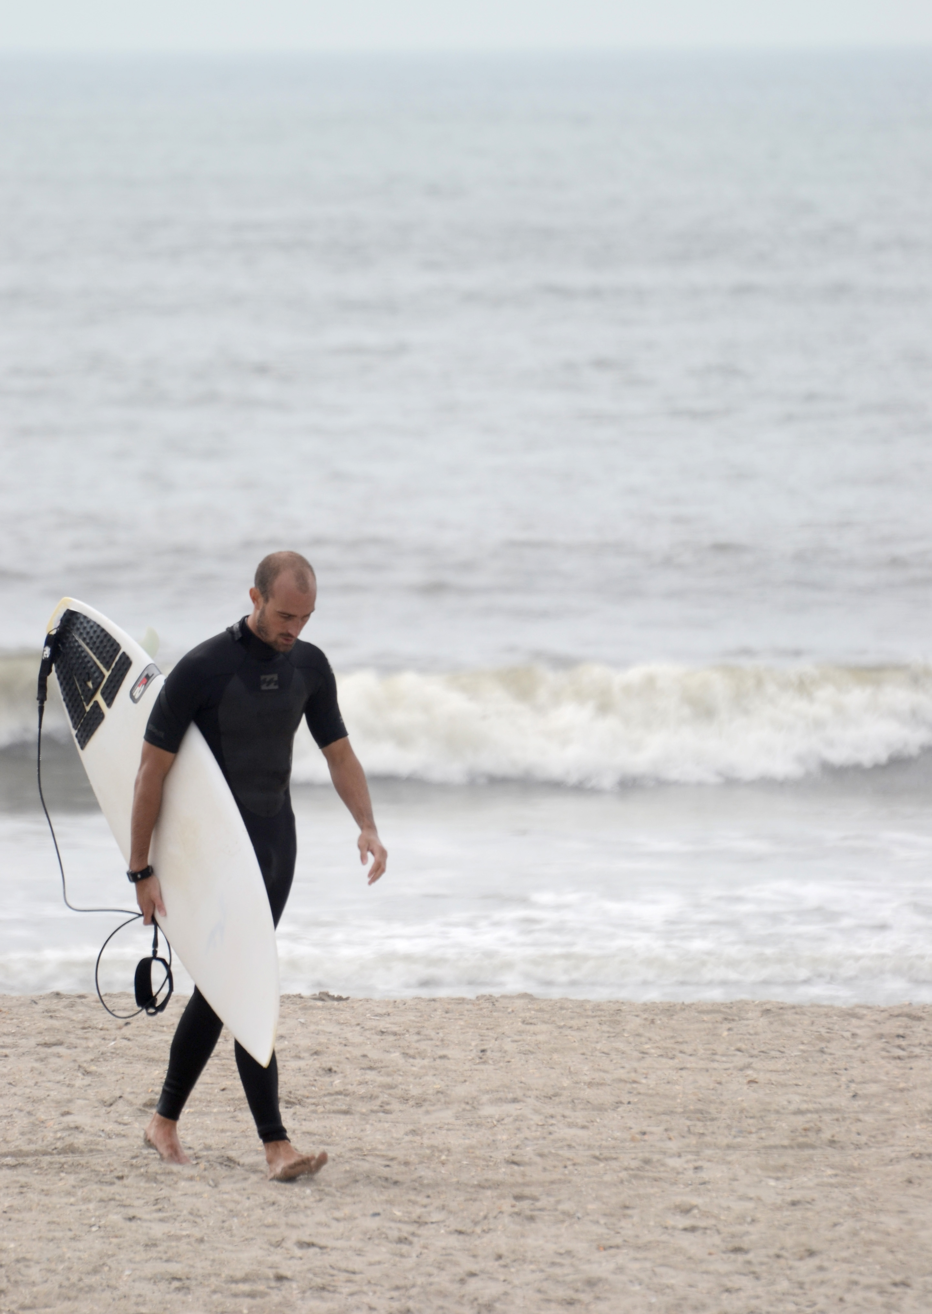
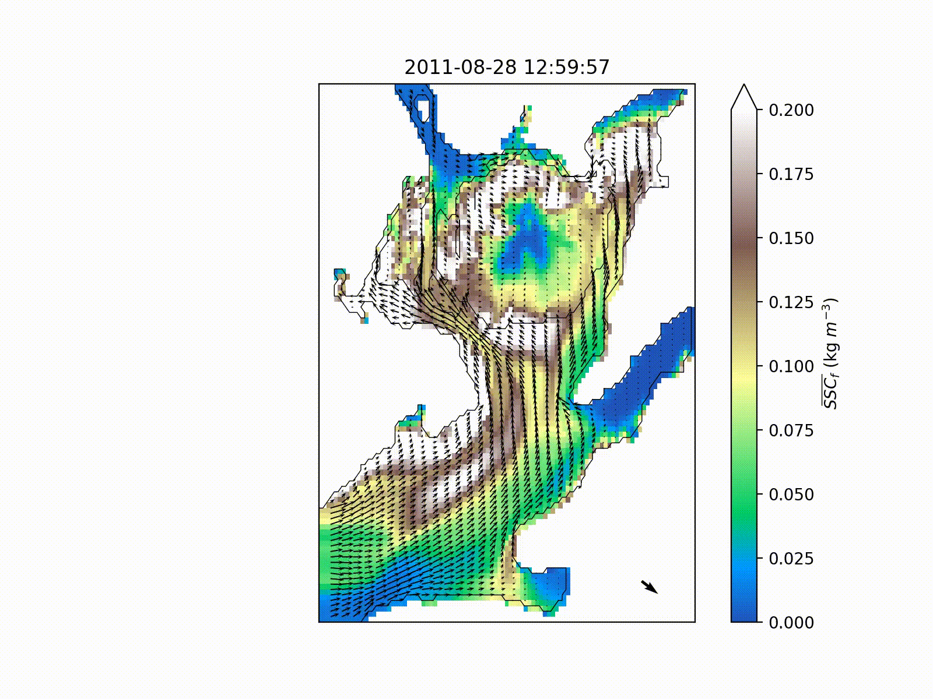




About me
B.S. Oceanography – Humboldt State University
M.Sc. Physical Oceanography – UMCES
>10 years experience at various data centers/repositories

Slide 3

Quiz time!
What is a repository?
Differences between code and data repositories?
Who do you turn in your data/results to?
Name a version control software (VCS)
What is a branch in git?
What is a package in Python?
Have you had trouble running code from others, or sharing your code?
Is interoperability important to you?
Do you feel there are too many standards to understand?

Slide 4







(Oceanography) Data Stewards Salad
ESIP
RDA
EarthCube
FAIR
Ocean Best Practices
DataONE
IEDA
Force11
TDWG
And so on…

Slide 5
An Opinion of Two Cities: Science and Software
Science focused:
Repeatability, Replicability, Reproducibility
FAIR principles
Data centers/repositories
Methods repository - Ocean Best Practices
Software focused:
Community decisions in oceanography
Data essentials
Working environment: package managers, virtualization
Online interactive notebooks: Binder
Version control: git, Github
Code readability: formatters
Code readability part 2: docstrings/comments, autodocs
Variable names and standard vocabularies
Licensing code and data
DOIs for code and data

Slide 6
Repeatability, Replicability, Reproducibility
Repeatability: Same team, same experimental setup
Replicability: Different team, same experimental setup
Reproducibility: Different team, different experimental setup
Methods reproducibility: provide sufficient detail about procedures and data so that the same procedures could be exactly repeated.
Results reproducibility: obtain the same results from an independent study with procedures as closely matched to the original study as possible.
Inferential reproducibility: draw the same conclusions from either an independent replication of a study or a reanalysis of the original study.
Plesser HE (2018) Reproducibility vs. Replicability: A Brief History of a Confused Terminology. Front. Neuroinform. 11:76. doi: 10.3389/fninf.2017.00076

Slide 7
FAIR Principles
Make data easier to use: “guidelines to improve the findability, accessibility, interoperability, and reuse of digital assets”
What does FAIR mean?
Findable
Accessible
Interoperable
Reusable
“Is your data FAIR?” vs “Does your data follow FAIR virtues?”
Absolutes versus relatives – start with the relatives
https://www.go-fair.org/fair-principles/

Slide 8






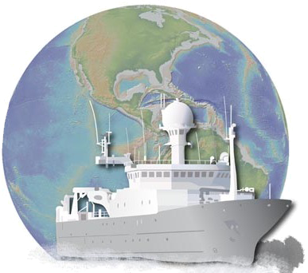
Data Centers/Repositories
Data centers are paid to make your data available – talk to us!
(It’s also a requirement of your grant to submit your data)
Use our libraries to read our data holdings, or ask us to make them
CCHDO/hydro, robis, gliderpy, etc
Feel free to contribute too!

Slide 9

Repositories of Methods
Ocean Best Practices
DOIs for manuals and handbooks
How to do fieldwork, make models, etc.
UNESCO/IOC project
Internationally agreed upon methods…
…and publically submitted methods
protocols.io
A secure platform for developing and sharing reproducible methods.

Slide 10
Reproducible Software: Opinionated Practices

Slide 11
Why spend effort for reproducibility?
Faster deployment of code
Faster understanding of code
Easier extension of code
Provenance
It’s good for you and the community!
See AGU guidance (https://doi.org/10.1029/2021EA001797)
See AMS policy on software (link)
What is reproducibility?
Read more than write – can you read it one month, year from now?
New installs over current- can you install it one month, year from now?
Code brittleness – can you extend it one month, year from now?

Slide 12
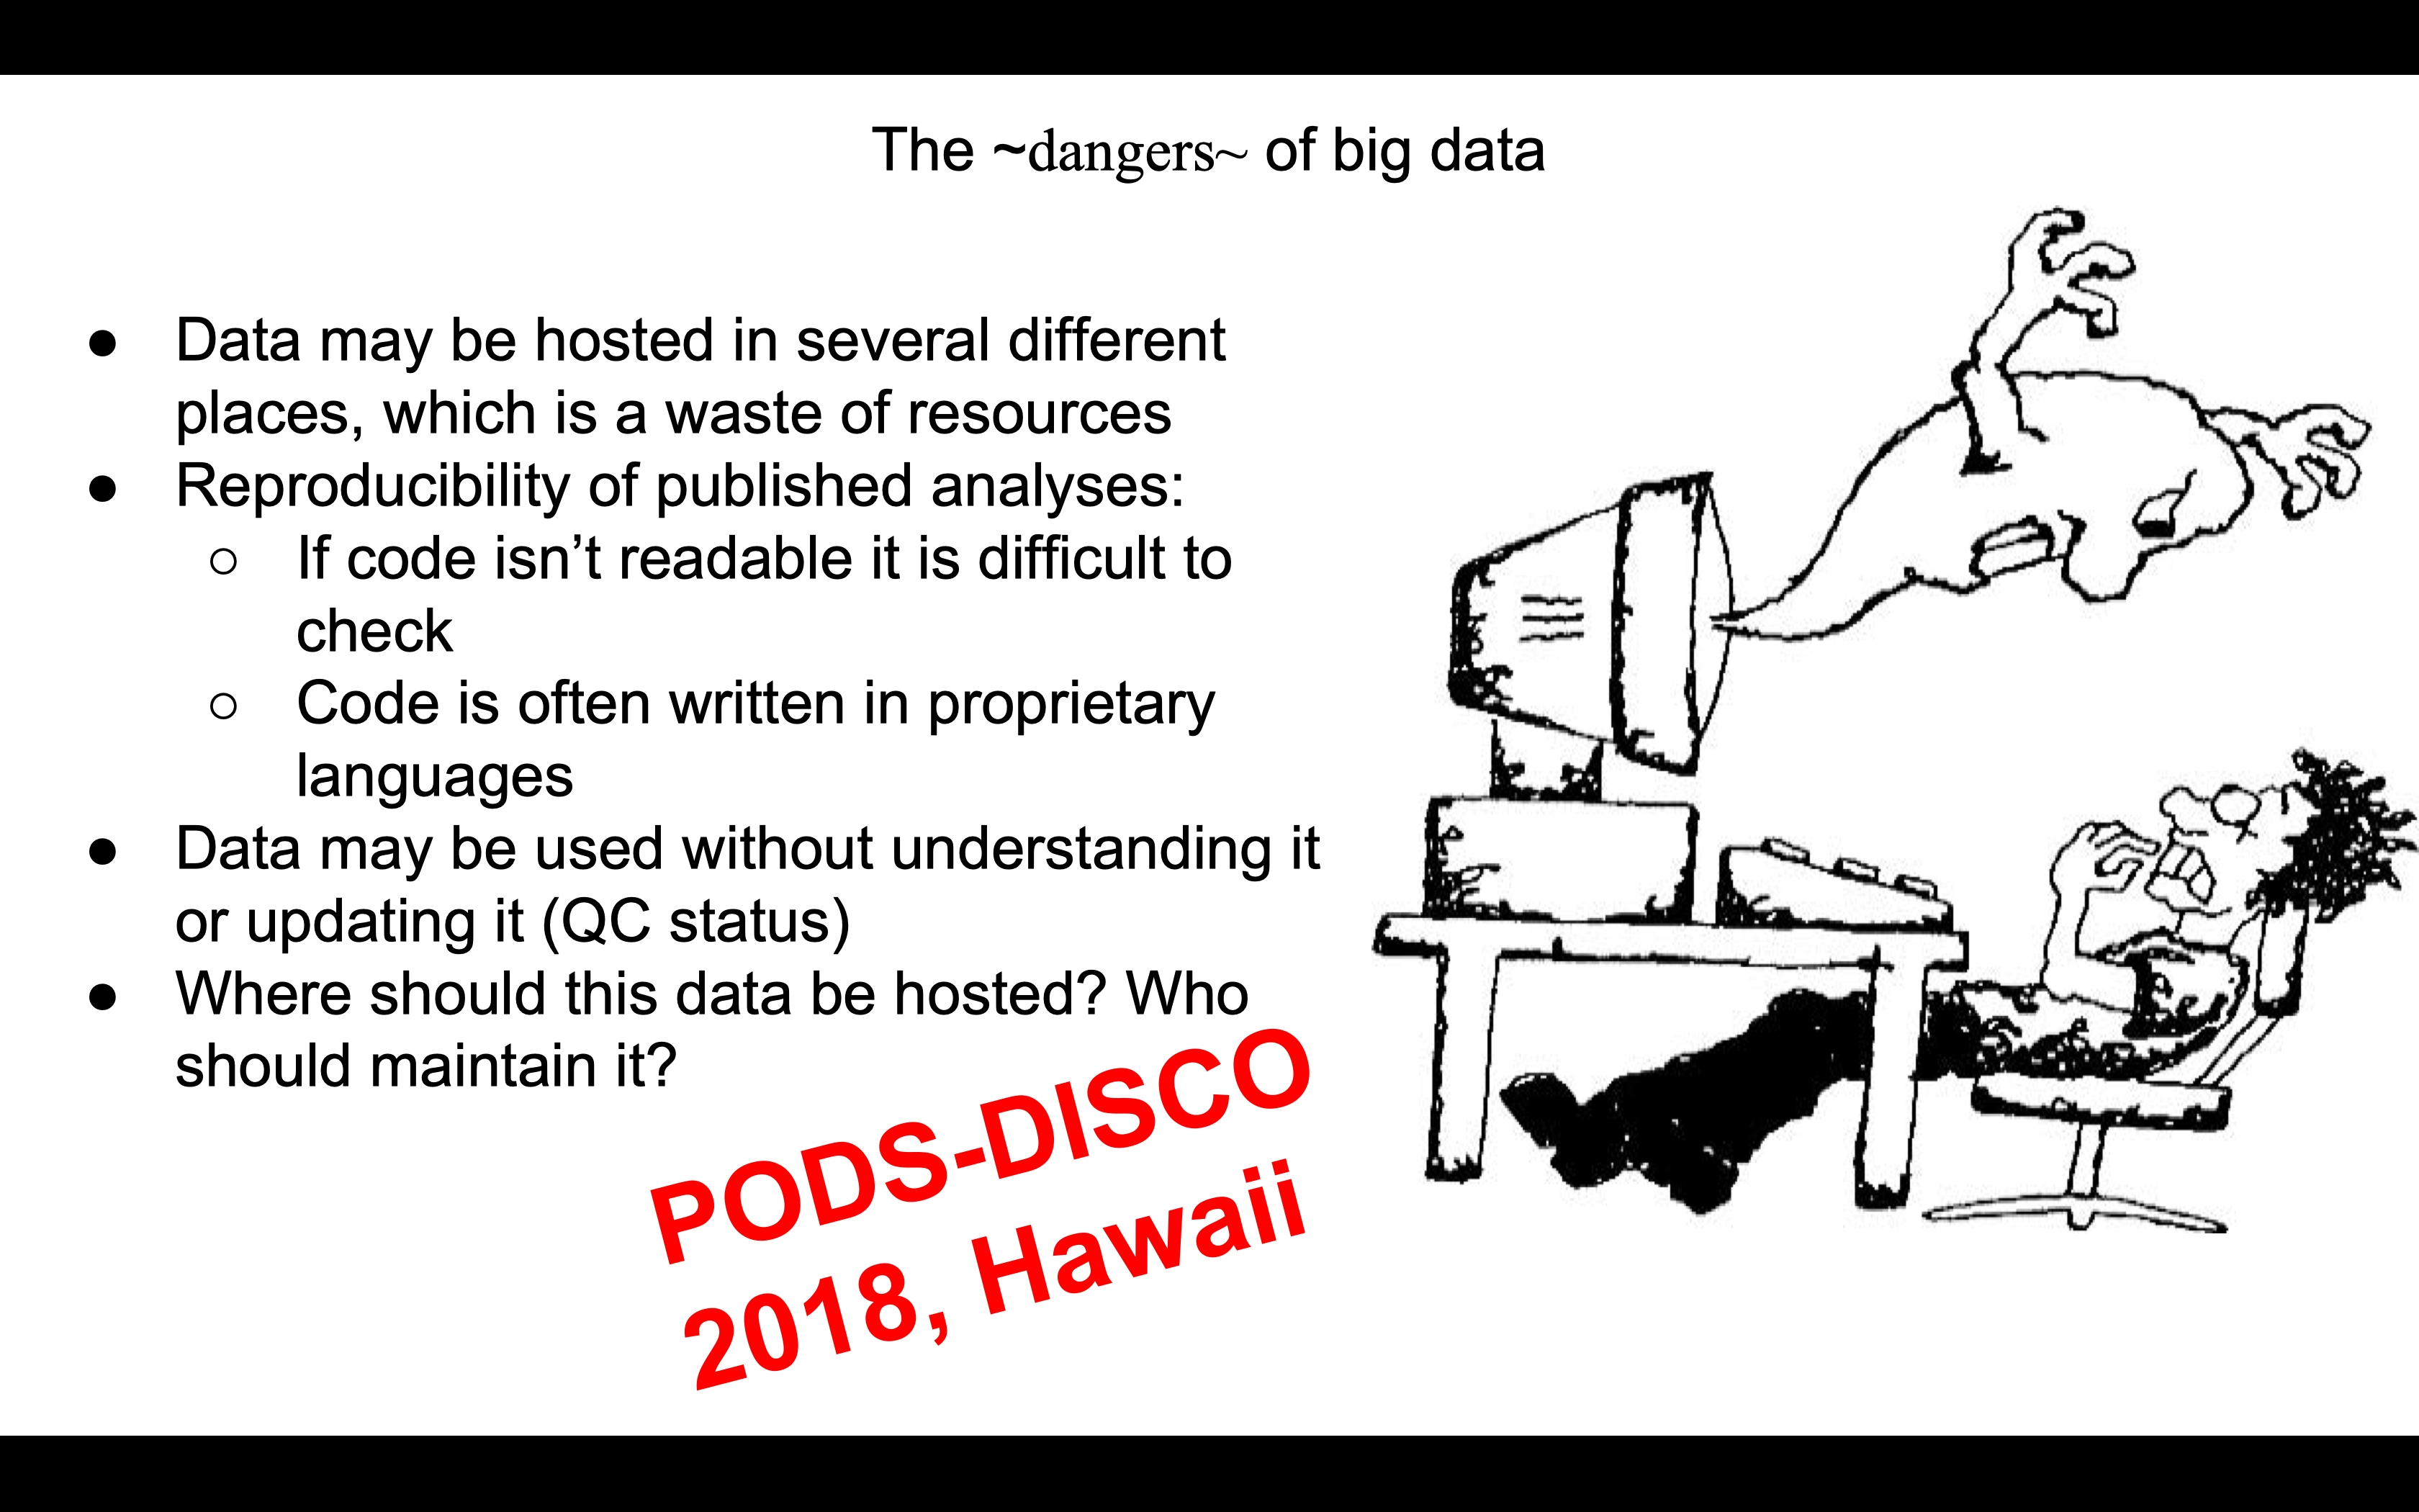
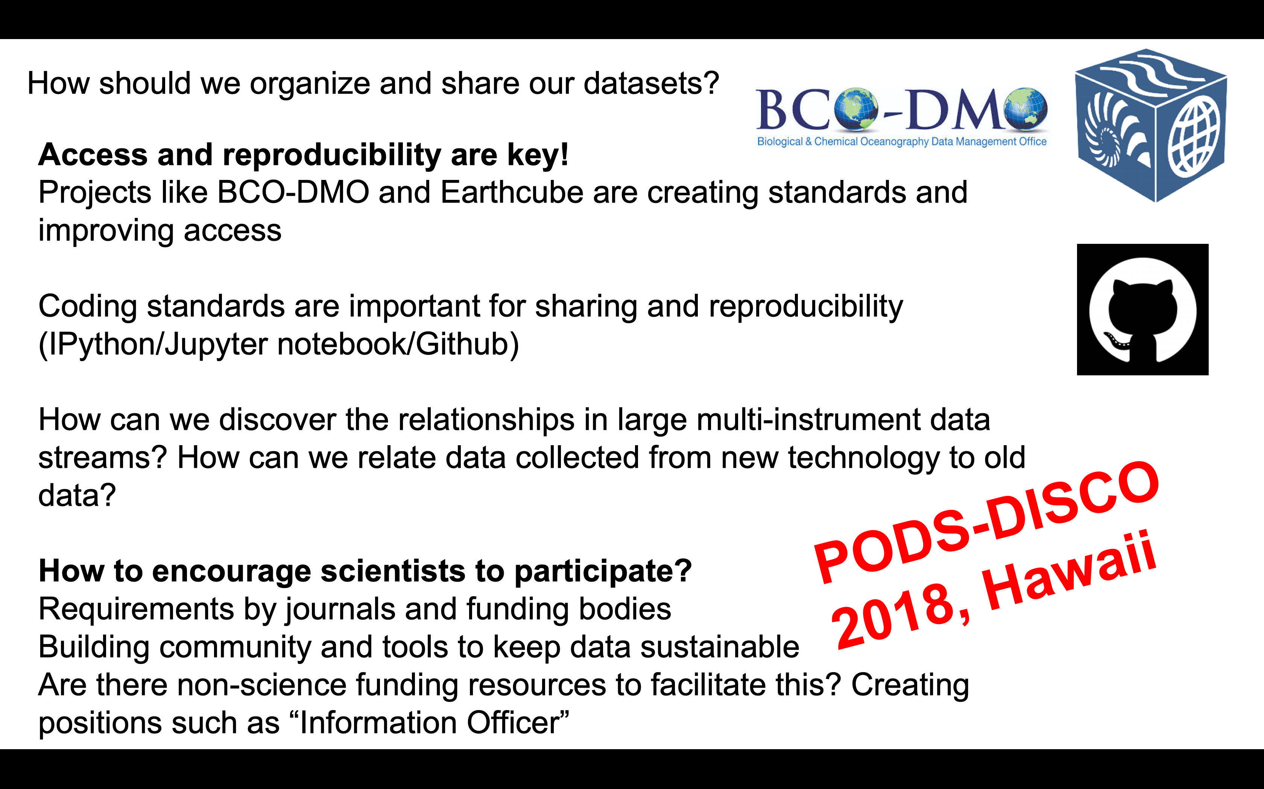
Lets see what some people have said about software, data before:

Slide 13



Community Decisions - Oceanography
Formats:
netCDF (CF, ACDD, NCEI netCDF Templates, IOOS Metadata Profile, etc.)
DarwinCore – Occurrence/Environmental Observations
MiXS – genomics
BIOM – contingency tables
Descriptive metadata (ISO 19115-2, EML, etc.)
Standard Vocabularies
Regulated vocabularies with strict definitions
Propose new names, pass committee approval
CF – Physical parameters
NERC Vocabulary Server – Collection of vocabularies
WoRMS / ITIS - Taxonomy
Cloud: Pangeo
Standardizing environments to make it easier to run code
Tools
ioos_qc (QARTOD), compliance-checker, erddapy

Slide 14

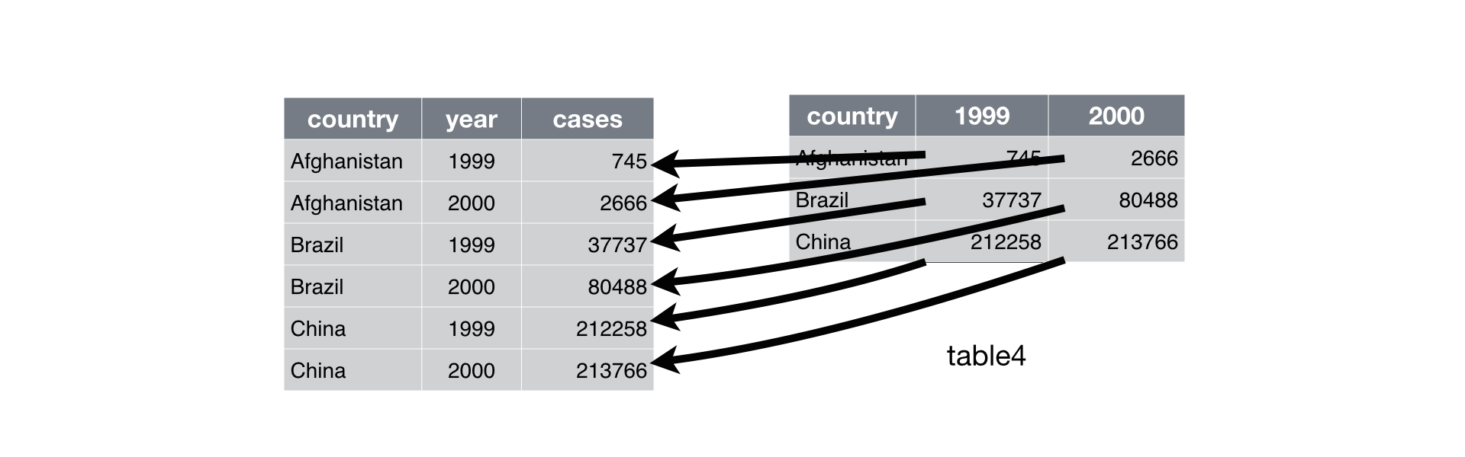
The essentials for data
Tidy data
Follow ISO 8601 for dates
YYYY-MM-DDTHH:mm:ssZ (eg. 2021-08-05T12:38:22Z)
Include the time zone!
Latitude and Longitude in decimal degrees WGS84.
Don’t imbed data in the column headers.

Slide 15
How do we standardize our coding practices?
“Opinionated” guidelines – PEP-20, ”This is the way we are doing things”
More people following the same opinionated practices – easier to share code!
PLoS: Ten simple rules for writing and sharing computational analyses in Jupyter Notebooks (link)
Software tools to help write opinionated Python
Conda/Conda-forge
Black
isort (non-notebooks, production code)
Software tools to help facilitate opinionated Python
Git/Github
Binder
Sphinx (numpy docstrings)
Science decisions made by communities
netCDF-CF
Pangeo

Slide 16


Working environments
Simplify installing and setting up an environment to run code
Compartmentalization makes it easier to prevent unforseen mixing that leads to problems
Package manager:
Conda + conda-forge: easier installation of dependencies, environments
Pip: standard Python tool; if all of your packages are in there, fine! (probably not)
Virtualization:
Conda provides virtual environments like virtualenv
Docker, other tools are good for deployment

Slide 17


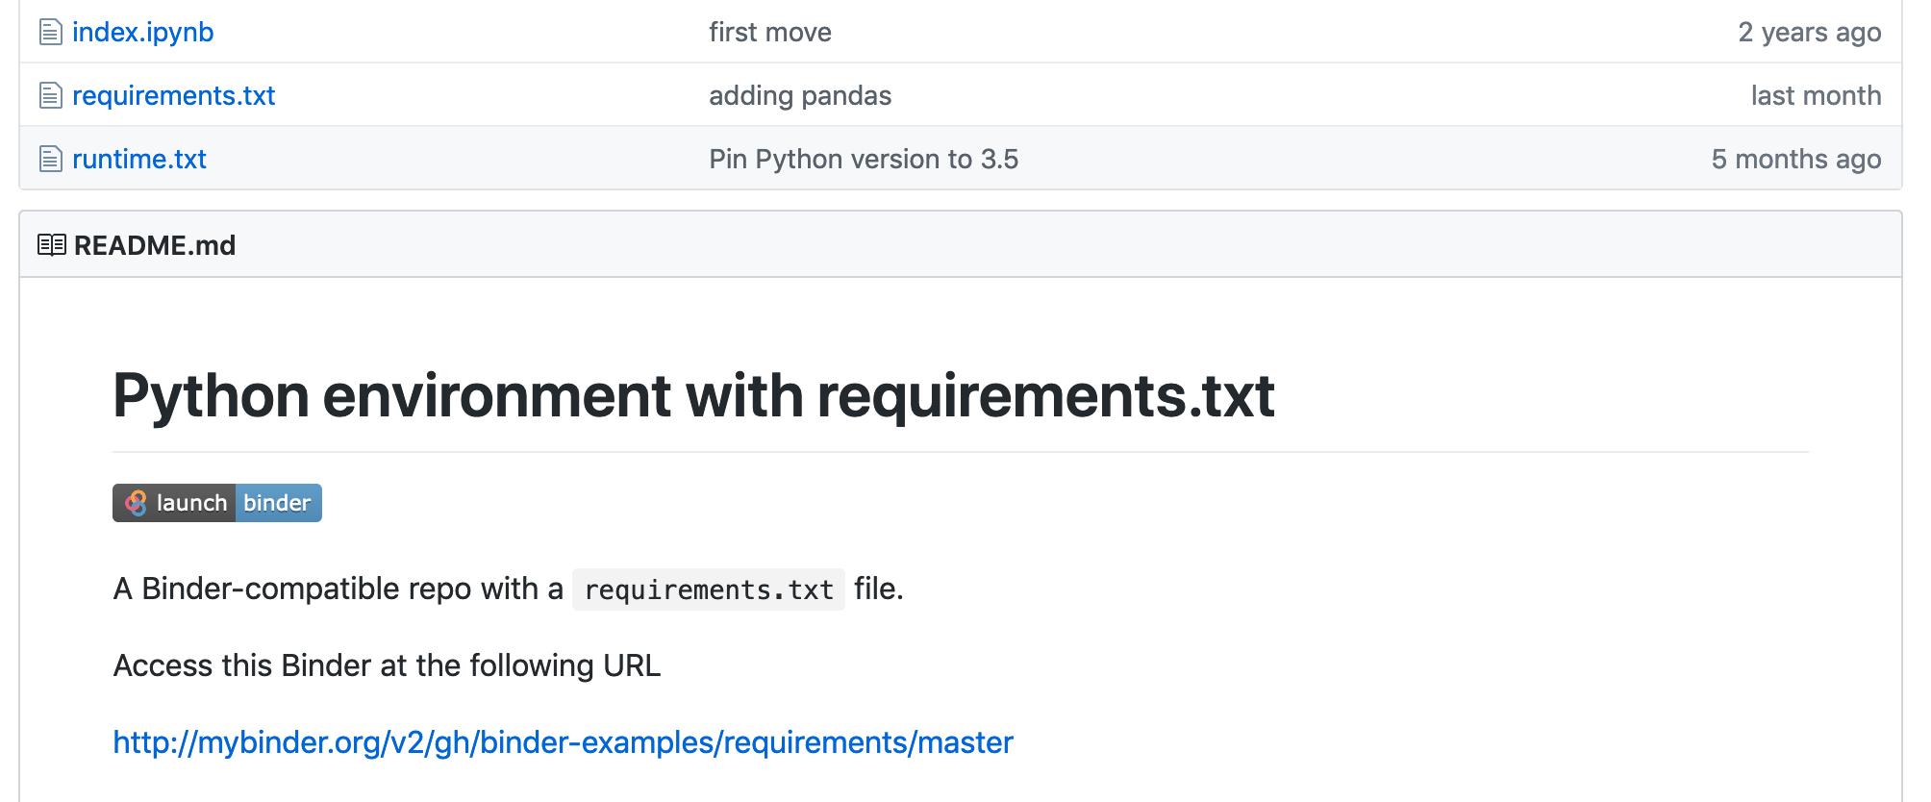
Platforms for running notebooks online
Binder - https://mybinder.org/
Plug-in to GitHub
Google Colab - https://colab.research.google.com/
Straight from Google Drive
Allow others to experiment with your code before downloading
Make DOI notebooks runnable

Slide 18

Version Control: git, Github
Easier to keep track of yours/others changes
Remote copies as failsafes in case of computer failure – but not a replacement for backups
Commits should be “atomic”
Commits are fully formed, not half-done
Related edits are grouped into a single commit
Commits are small (one change) and often
Use branches to try new ideas without polluting the master
Want more git tutorials?
Github – one of many places hosting code repos

Slide 19

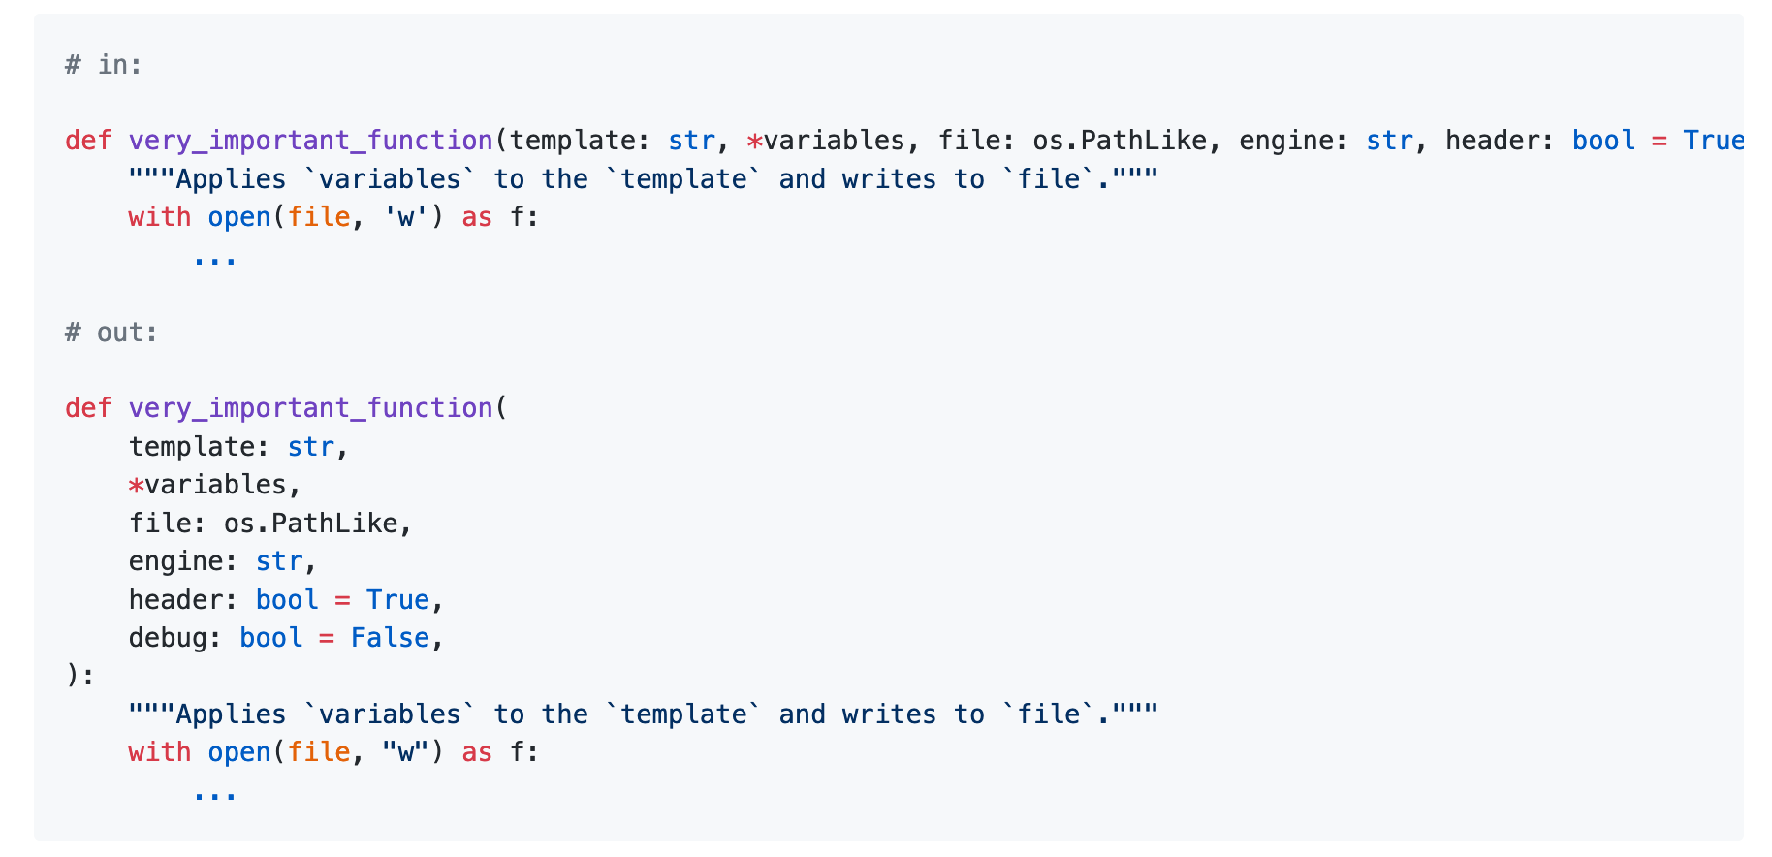
Code Formatting
Black: “The Uncompromising Code Formatter”
isort: Sort and trim imports; for production code, not notebooks

Slide 20
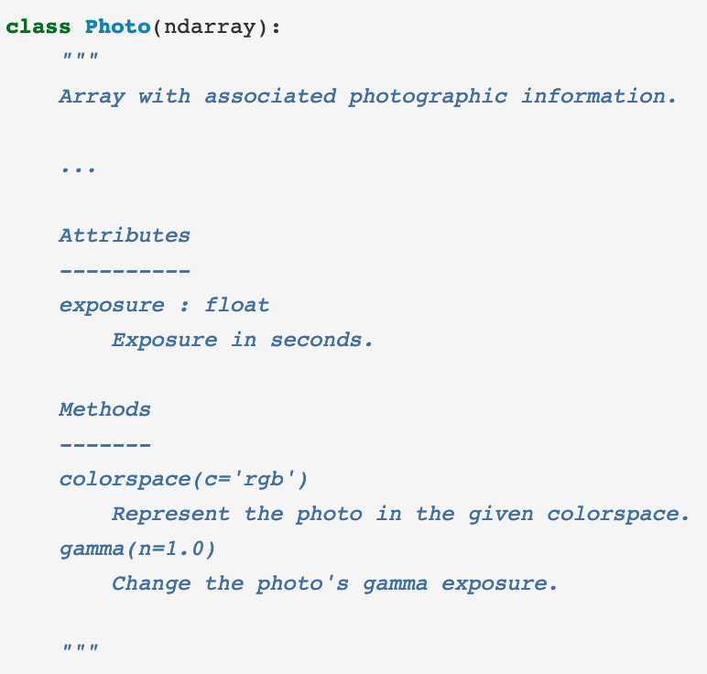


Code Readability part 2: comments and autodocs
Docstrings: format for writing documentation in Python
Flavors: Numpy, Google
Use numpy for your projects!
Document/Autodocs: Sphinx
Automatically generate code documentation
Make html, latex, pdf, plain text, etc.
Use with Read the Docs for free hosting
Jupyter{book}
Host with GitHub Pages and Actions

Slide 21




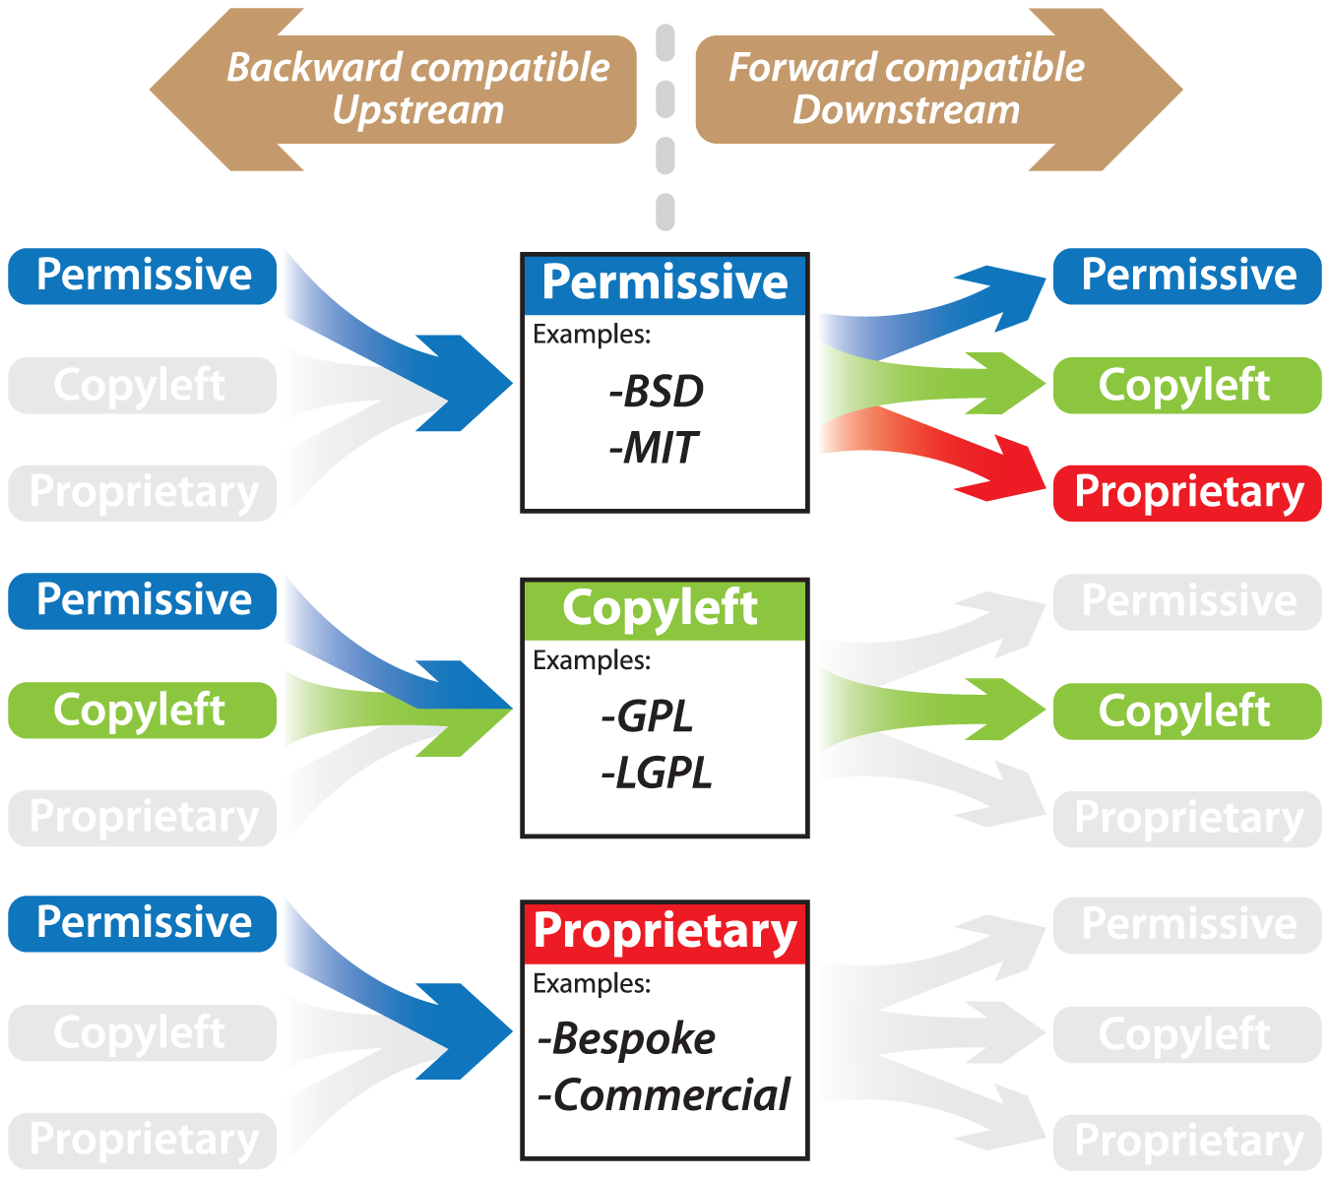
Licensing Code and Data
Tool to help you choose: https://choosealicense.com/
Software: MIT, BSD
Data: CC
USA government data licenses: ODC, CC, GNU (Federal only)
Publically funded data must be open access, data centers may license holdings
If no license is stated, a proprietary license is assumed - “all rights reserved”
doi: https://doi.org/10.1371/journal.pcbi.1002598.g002

Slide 22


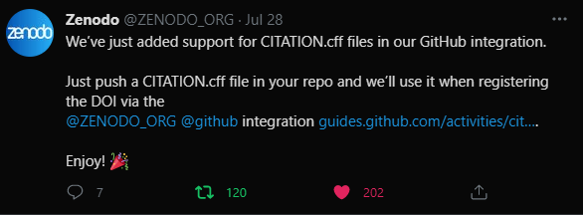

DOIs for Fun and Profit: Pt. 1
DOI – Digital Object Identifier, can be made by many organizations
Your institution may do so, but you don’t need to use them
Making DOIs for code
https://guides.github.com/activities/citable-code/
You can now supply your own citation information!
https://www.zenodo.org/
CodeMeta (metadata about software)
Making DOIs for data
Talk to your funder/repository first!
Your institutional repository may be able to make DOIs
Last ditch effort: zenodo

Slide 23
DOIs for Fun and Profit: Pt. 2
Citing DOIs:
Zenodo: lets look at 10.5281/zenodo.1256998
Choose citation style
Online tool: https://citation.crosscite.org/
10.7942/C2008W, “american-geophysical-union”, “en-US”
These tools depend on the DOI fields being filled out properly, so you don’t have to manually form them
Otherwise, follow recommended style
ESIP software and service citation guidelines. (link)
Author. (Publication Year). Title. Version No. Publisher. PID URL. Access Date.

Slide 24
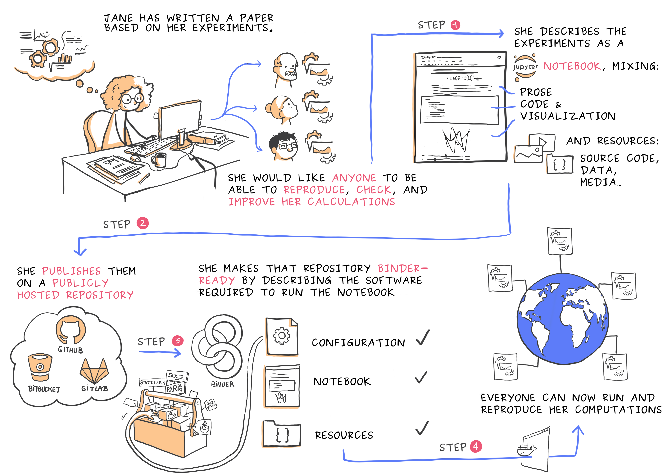
Future– Executable paper
Juliette Taka, & Nicolas M. Thiéry. (2018). Publishing reproducible logbooks explainer comic strip. Zenodo. https://doi.org/10.5281/zenodo.4421040

Slide 25
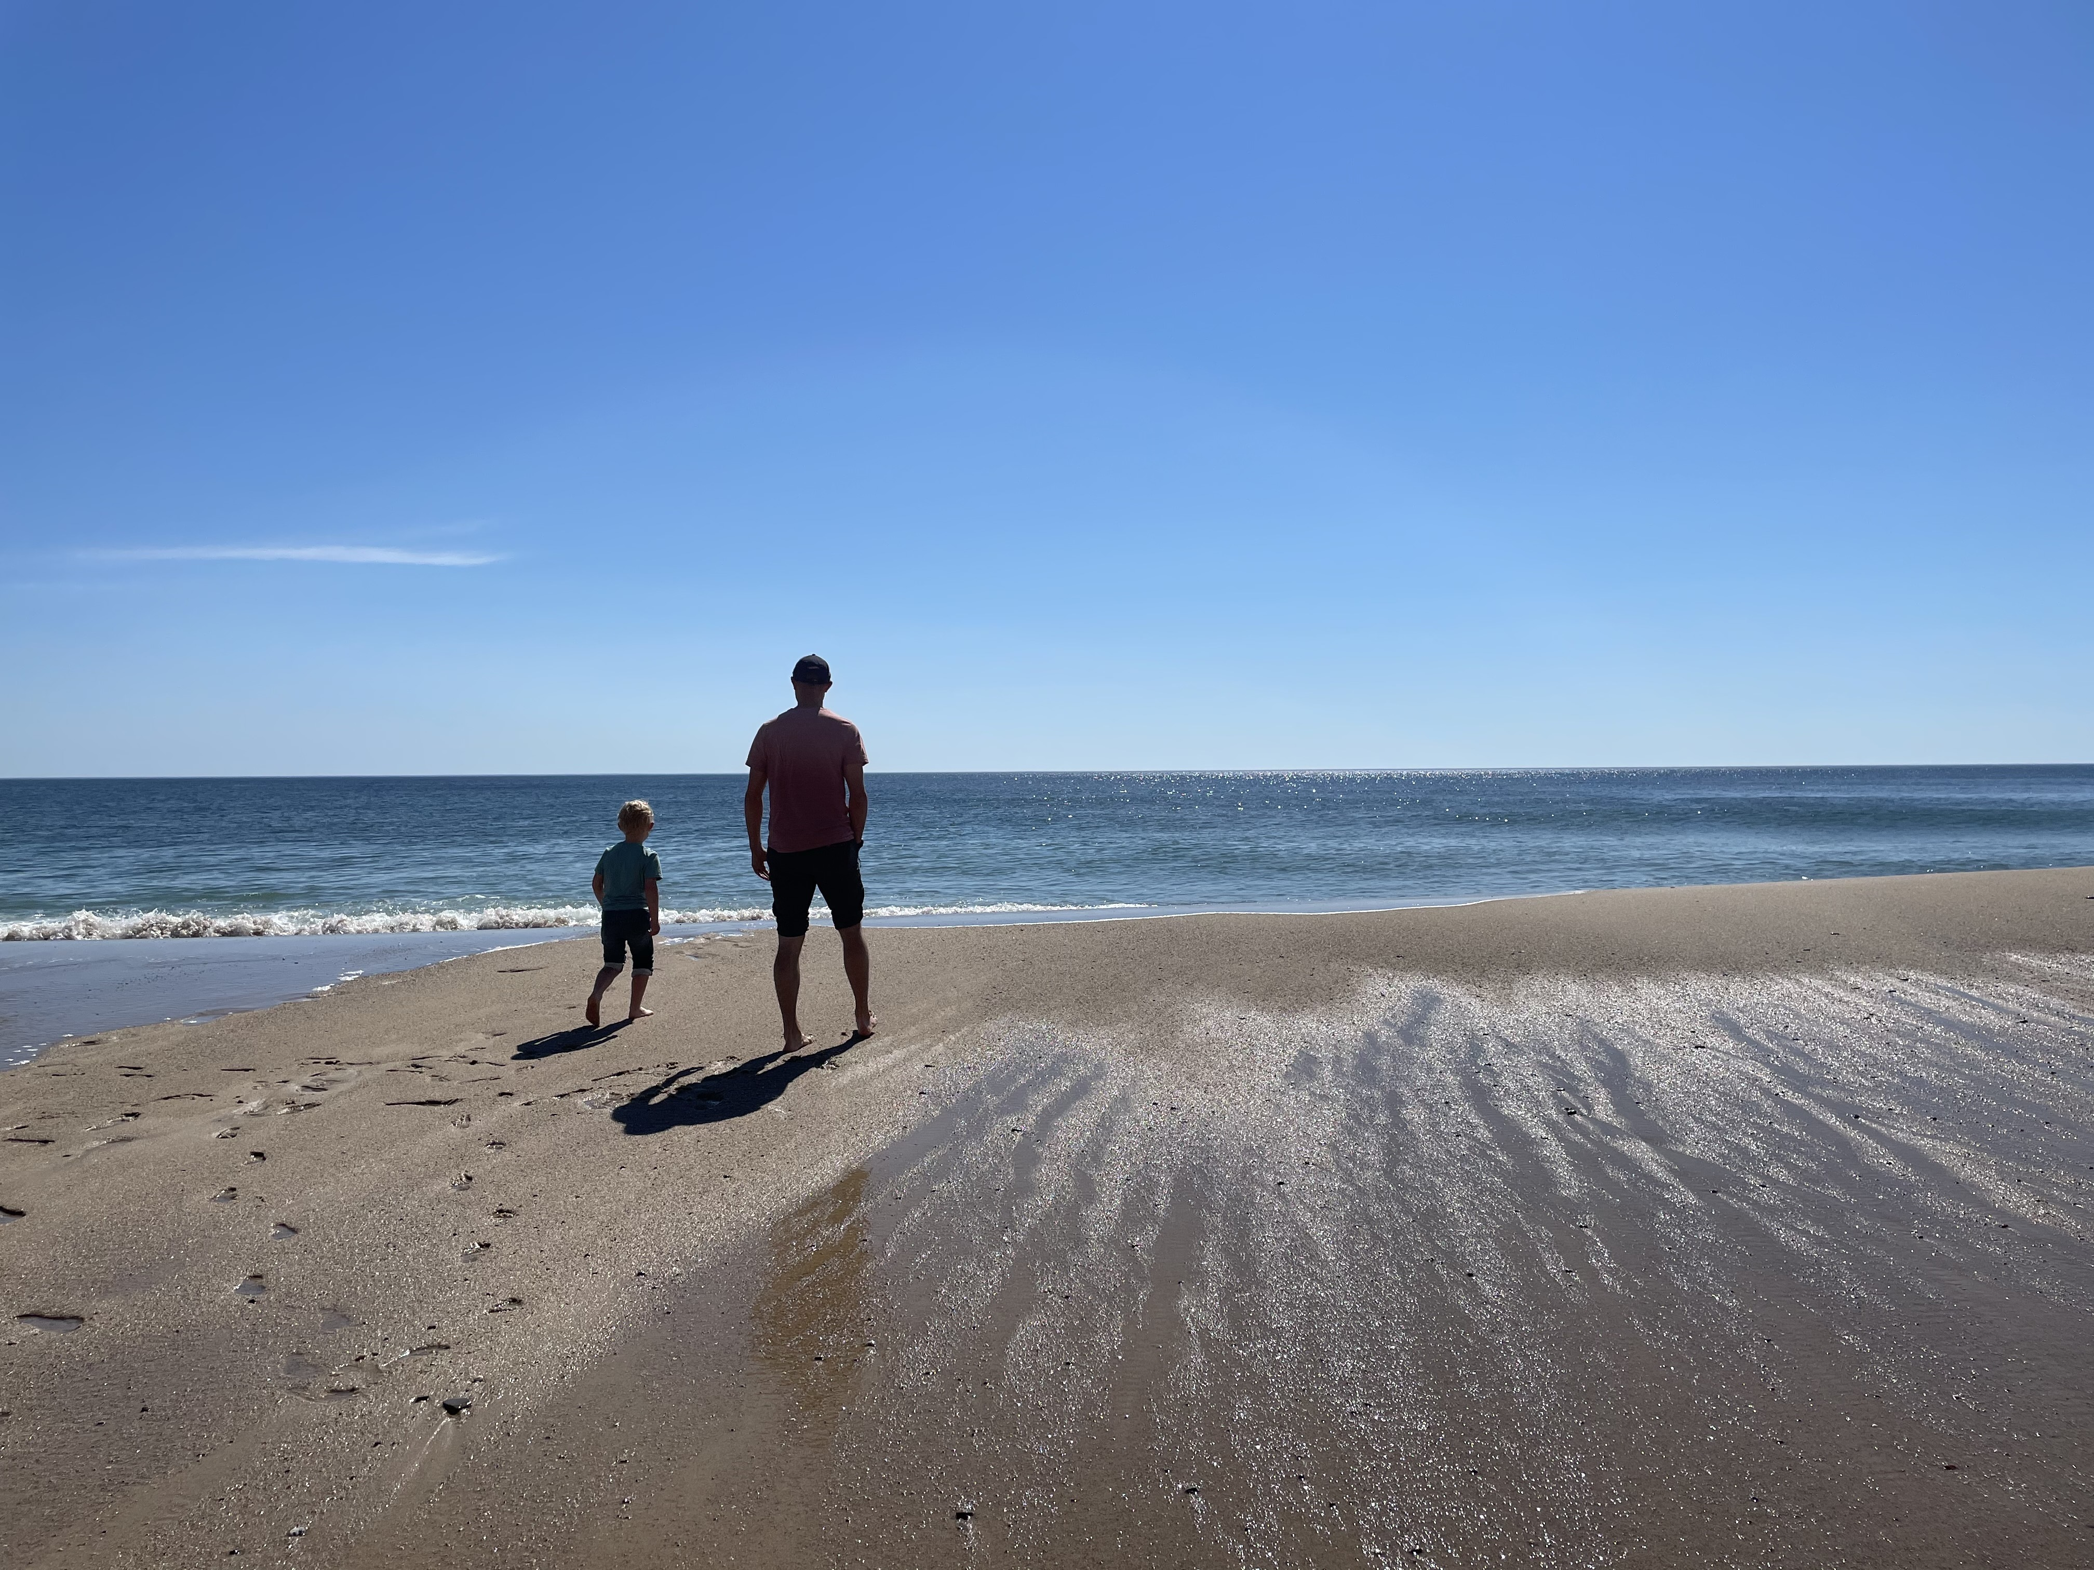
Thank you for attending OceanHackWeek 2021!
Mathew Biddle
Data Management Analyst
Integrated Ocean Observing System Office
Mathew.Biddle@noaa.gov
ORCiD: 0000-0003-4897-1669

Slide 26
Extra slides

Slide 27
Code readability – variable names
Context is important
Internal functions vs public API vs data products?
Equations implemented in code can make sense to use shorter names
Variable names
Temperature: temperature, temp, tmp, T, sea_water_temperature, sea_surface_skin_temperature, TEMPP681, TMESOT01
Those names in blue are from standard vocabularies
Controlled, publically available, names added after proposal process
Group Examples: CF, SeaVox, NERC Vocabulary Server

Slide 28



Advanced Software Engineering
Python language power features:
Logging, factories, list comprehensions, etc.
APIs
Data: JSON, YAML, XML, REST, SOAP, etc.
Packaging
Version schemes
Continuous Integration (CI)
Special mention: Pre-commit
GitHub Actions
Tests
Unit, system/holistic
Images/Containers
“Better is the enemy of good”

